Slide 1




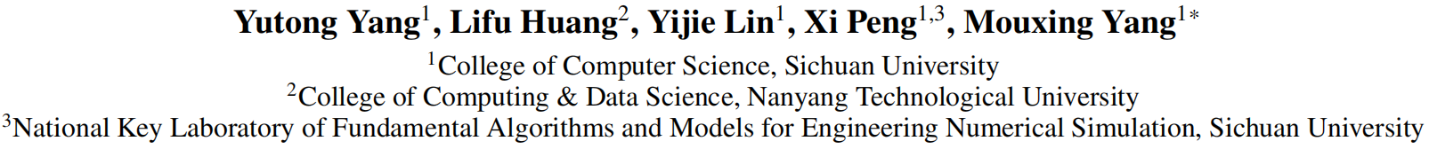





ATAI
Advanced Techniqueof Artificial Intelligence
ATAI
ChongqingUniversity _{AdvancedTechniqueof}
of Technology Artificial Intelligence
Chongqing University of
Technology
Chongqing University ^{ATAI}
_{of Technology} Advanced Techniqueof
Artificial Intelligence
Chongqing University of Technology
Chongqing University of Technology
Endowing Vision-Language Models with System 2 Thinking for Fine-Grained Visual Recognition
Code:https://github.com/XLearning-SCU/2026-AAAI-SCAN
2026.3.4 •ChongQing
—— AAAI_2026
Reported by Lele Ren
1

Slide 2

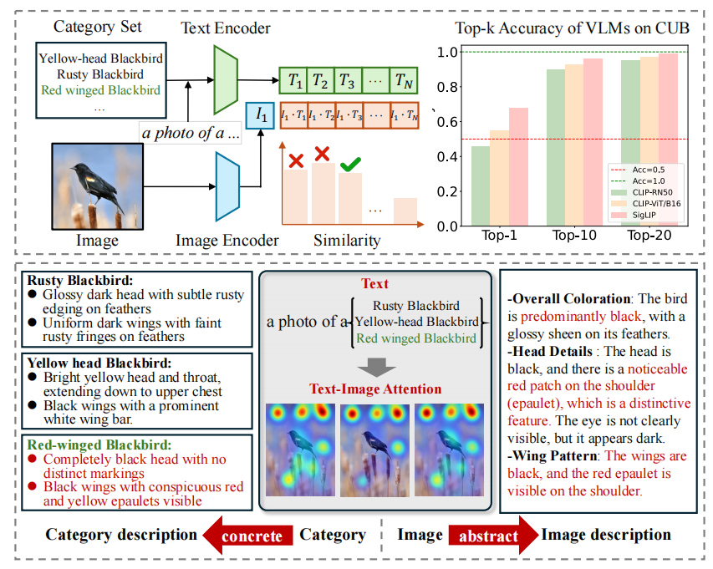
ATAI
AdvancedTechniqueof
Artificial Intelligence
ATAI
ChongqingUniversity _{AdvancedTechniqueof}
of Technology Artificial Intelligence
ChongqingUniversity of Technology
Motivation
1. VLMs suffer from performance limitations in fine-grained visual recognition. Despite their excellent performance in general image recognition, they struggle to capture and distinguish the subtle visual differences between highly similar candidate categories, leading to a significant performance drop in such scenarios.
2. VLMs have exploitable potential: although VLMs yield a low Top-1 accuracy in fine-grained recognition, the correct category often appears among the top predictions (high Top-k accuracy). This means that VLMs are thus capable of quickly delimiting a reasonable range of candidate categories.

Slide 3

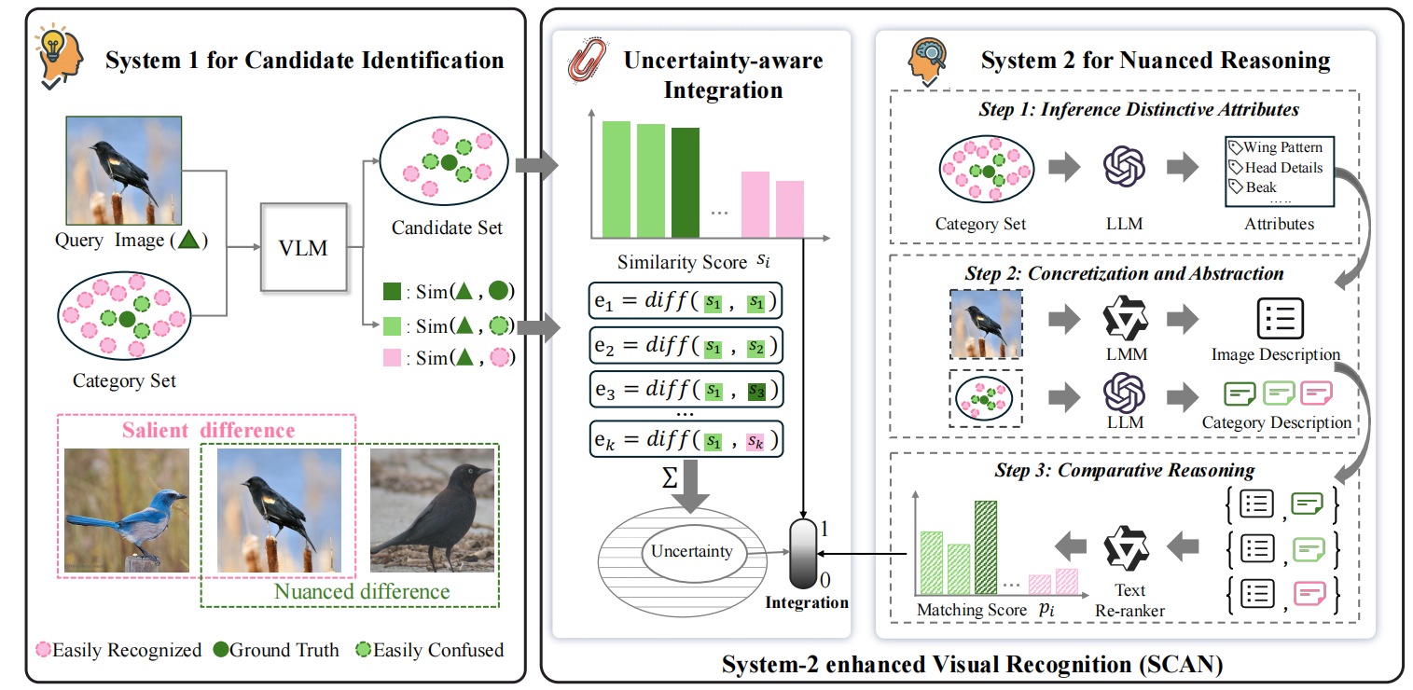
ChongqingUniversity of Technology
ATAI
AdvancedTechniqueof
Artificial Intelligence
ATAI
ChongqingUniversity _{AdvancedTechniqueof}
of Technology Artificial Intelligence
Overview

Slide 4
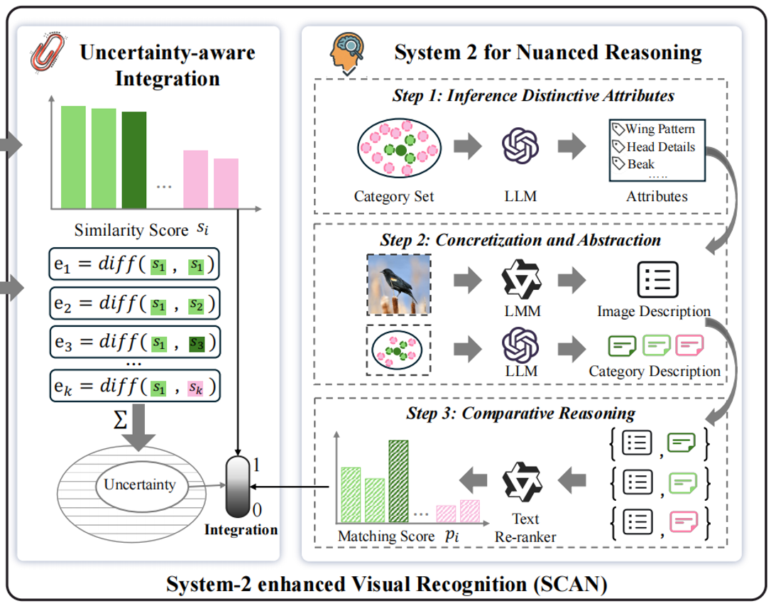




ChongqingUniversity of Technology
ATAI
AdvancedTechniqueof
Artificial Intelligence
ATAI
ChongqingUniversity _{AdvancedTechniqueof}
of Technology Artificial Intelligence
Method

Slide 5

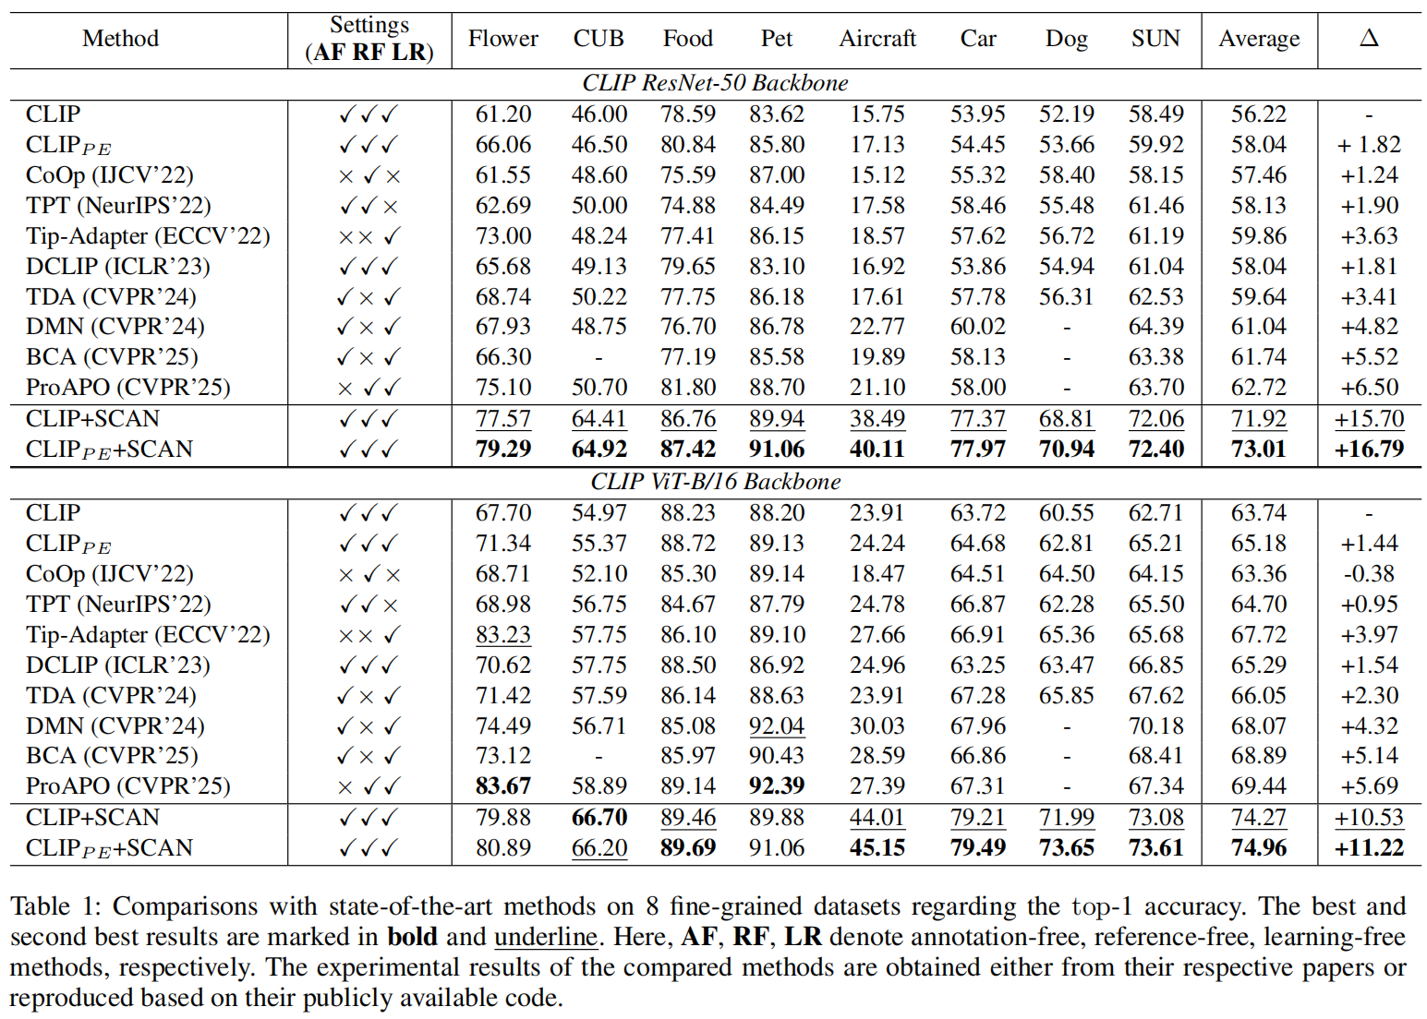
ATAI
AdvancedTechniqueof
Artificial Intelligence
ATAI
ChongqingUniversity _{AdvancedTechniqueof}
of Technology Artificial Intelligence
ChongqingUniversity of Technology
Experiments

Slide 6
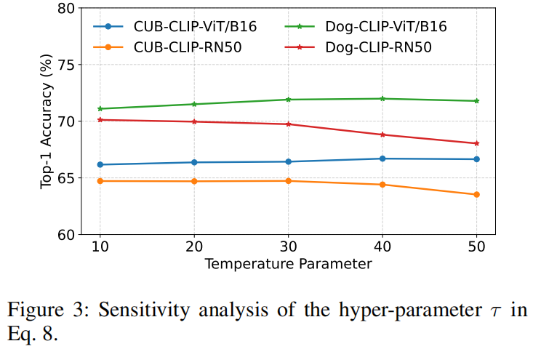
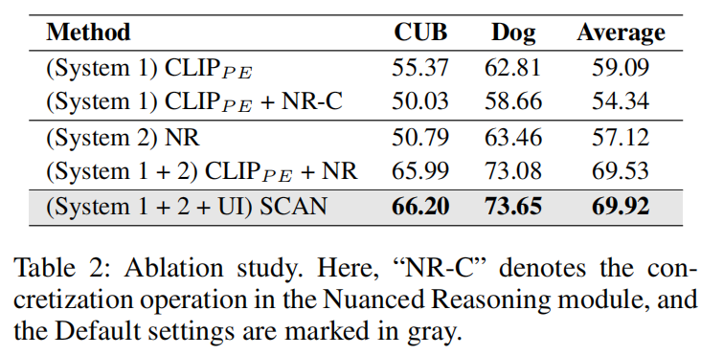
ATAI
AdvancedTechniqueof
Artificial Intelligence
ATAI
ChongqingUniversity _{AdvancedTechniqueof}
of Technology Artificial Intelligence
ChongqingUniversity of Technology
Experiments

Slide 7
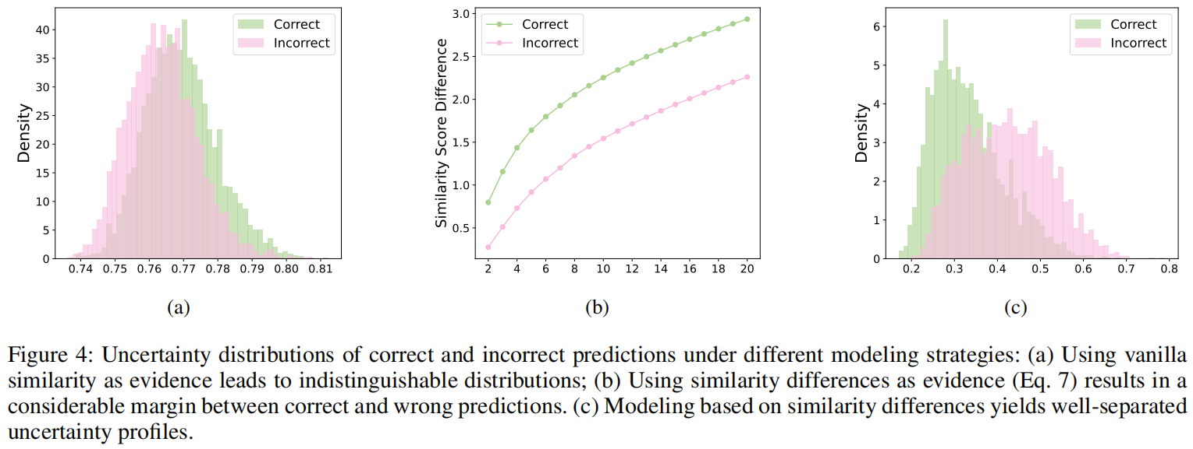
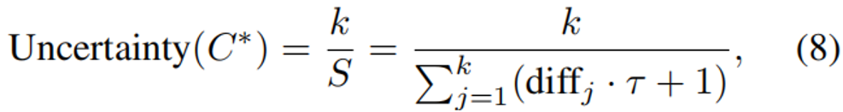
ATAI
AdvancedTechniqueof
Artificial Intelligence
ATAI
ChongqingUniversity _{AdvancedTechniqueof}
of Technology Artificial Intelligence
ChongqingUniversity of Technology
Experiments

Slide 8
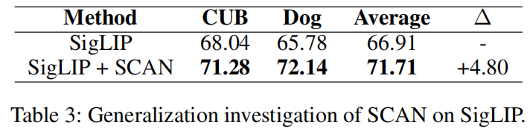
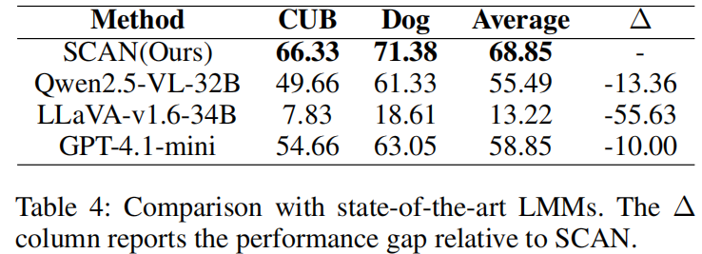
ATAI
AdvancedTechniqueof
Artificial Intelligence
ATAI
ChongqingUniversity _{AdvancedTechniqueof}
of Technology Artificial Intelligence
ChongqingUniversity of Technology
Experiments

Slide 9


ChongqingUniversity of Technology
ATAI
AdvancedTechniqueof
Artificial Intelligence
ATAI
ChongqingUniversity _{AdvancedTechniqueof}
of Technology Artificial Intelligence
Thanks!

